Slide 1
Survival Analysis: An Overview

Slide 2

Survival Analysis Terminology
Event: The event/ experience of interest
Examples:
Cardiovascular death after some treatment intervention
Machine part failure
Cancelation of a subscription
Departure of an employee
Survival Time: The duration of time UNTIL the event of interest occurs
Examples:
Time until cardiovascular death after some treatment intervention
Time until a machine part fails
Time until a customer cancels subscription
Time until an employee leaves the company

Slide 3
Survival Analysis Terminology
Censoring
Given that in many cases we are not able to observe the subjects (patients, customers, …) during their entire lifespan, the data in survival analysis is often “censored”. That is, for some subjects we may not know the exact time of treatment, for some of them we may not know the exact time of event, and for some subjects we may know neither. In survival analysis, we learn how to deal with situations like these.
Fixed type I censoring occurs when a study is designed to end after C years of follow-up. In this case, everyone who does not have an event observed during the course of the study is censored at C years.
In random type I censoring, the study is designed to end after C years, but censored subjects do not all have the same censoring time. This is the main type of right-censoring we will be concerned with.
In type II censoring, a study ends when there is a pre-specified number of events.

Slide 4
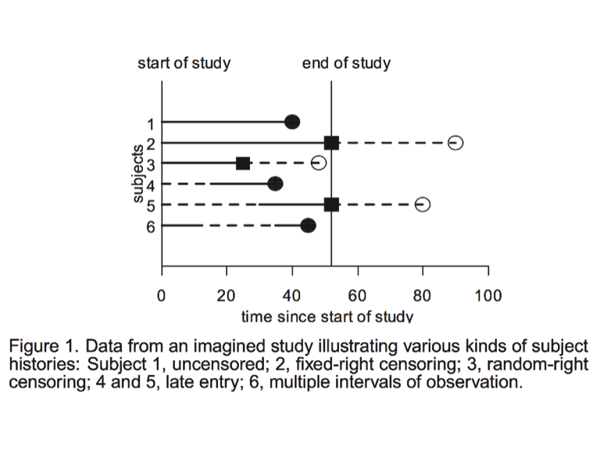
Survival Analysis Terminology

Slide 5
Quiz
If none of the data points were censored, could we use linear regression instead of survival analysis?
Time to event is restricted to be positive and has a skewed distribution.
The probability of surviving past a certain point in time may be of more interest than the expected time of event.
The hazard function, used for regression in survival analysis, can lend more insight into the failure mechanism than linear regression.

Slide 6
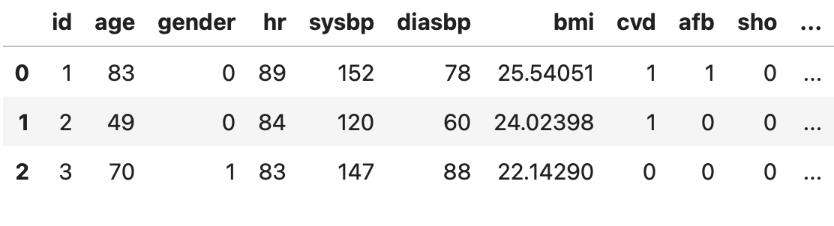
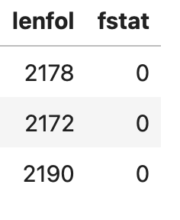
Survival Data
1- The survival time of each subject, or the time at which the observation for the subject is censored.
2- Whether the subject’s survival time is censored.
3- In most interesting analyses, the values of one or more explanatory variables (covariates) thought to influence survival time. The values of (some) covariates may vary with time.

Slide 7
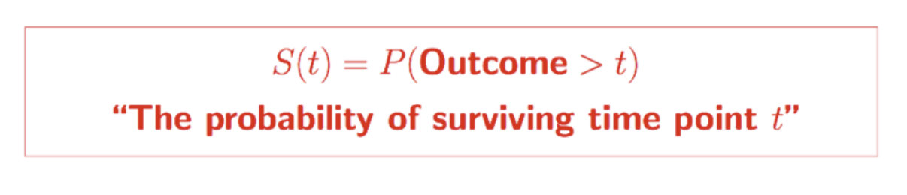
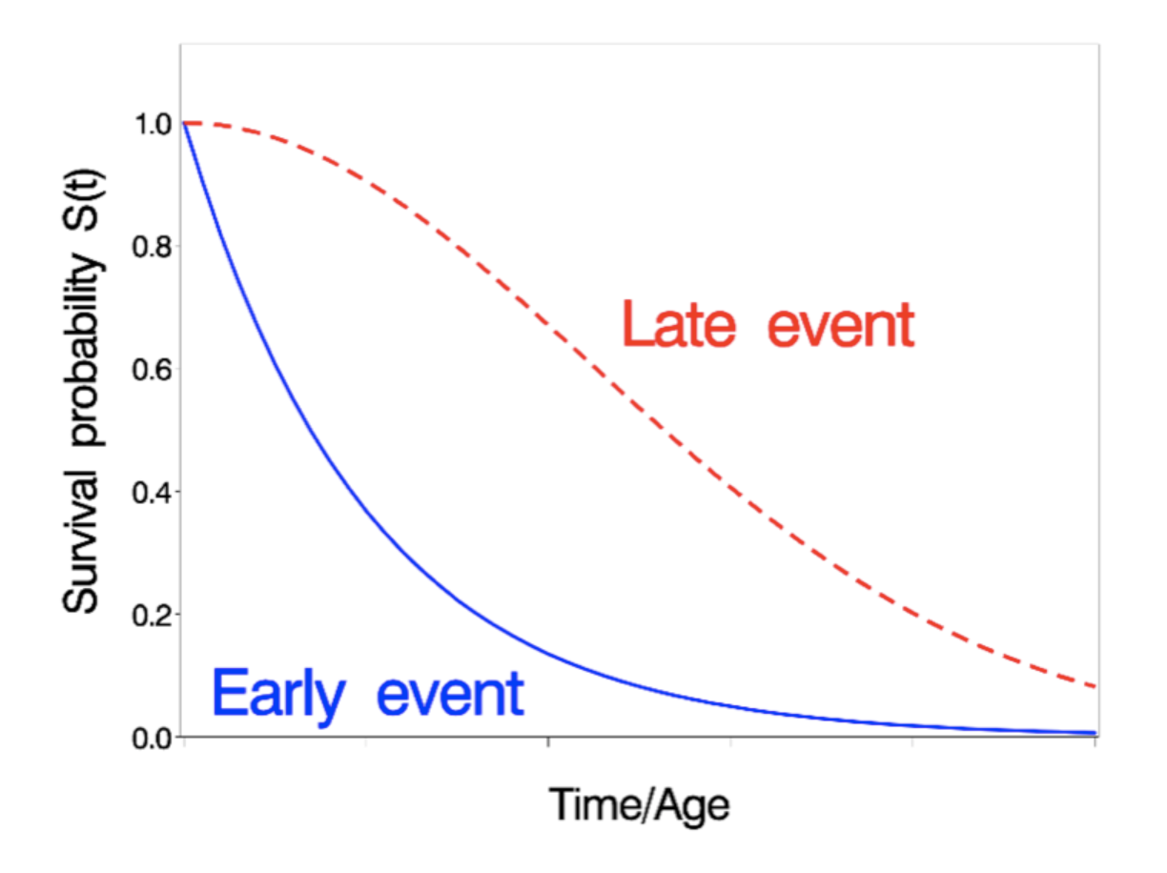
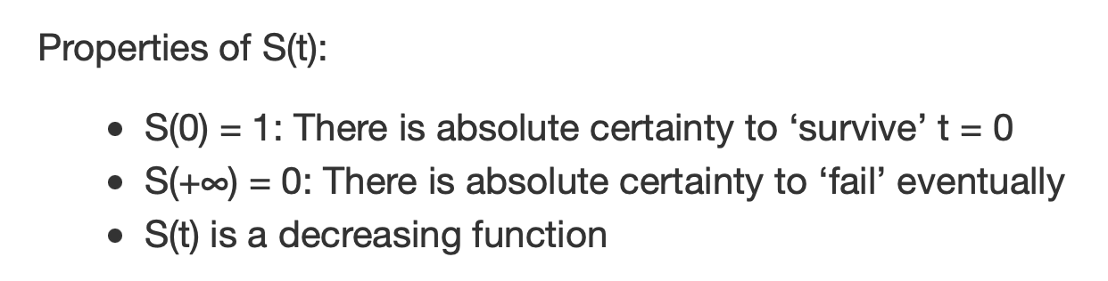
Survival Function

Slide 8
?

